Slide 1
Fuel Price Data Analysis with PySpark
Presented by:
Sushan Kattel
Rojesh Pradhananga
Mentor:
Amrit Prasad Phuyal

Slide 2
Table of Contents
Introduction
More about dataset
Work division
Data Preprocessing
The Questions

Slide 3
Introduction
The dataset used in this project:
https://www.kaggle.com/datasets/alessandrolobello/gasoline-hourly-price-tracker-from-2022?select=Hourly_Gasoline_Prices.csv
This dataset contains information about fuel stations, petrol companies, types, station names, cities, and coordinates.
The project aims to analyze and process fuel price and station information data.
Our goal is to provide valuable insights into fuel pricing and station locations.

Slide 4
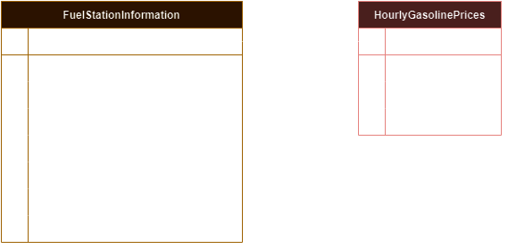
More About Dataset

Slide 5
Work Division
1) Dataset Searching - In Group
2) Preprocessing - Sushan
3) Researching questions - In Group
4) Individual questions - On own
5) Preparing Presentation - Rojesh
6) Preparing Readme.md file - Sushan
7) Merging Github - Sushan

Slide 6
Data Preprocessing
Data Loading: Load the csv data files
Duplicate Removal: Duplicates from both data were removed for data integrity.
Handling Null Values: Rows containing null values were dropped from both datasets.
Column Transformation: The "Date" column in the "Hourly Gasoline Prices" dataset was transformed into a timestamp format for easier analysis of time-series data.
Data Storage: Cleaned datasets were saved as Parquet files for efficient storage and retrieval in future analysis.

Slide 7
The 10 Questions !

Slide 8
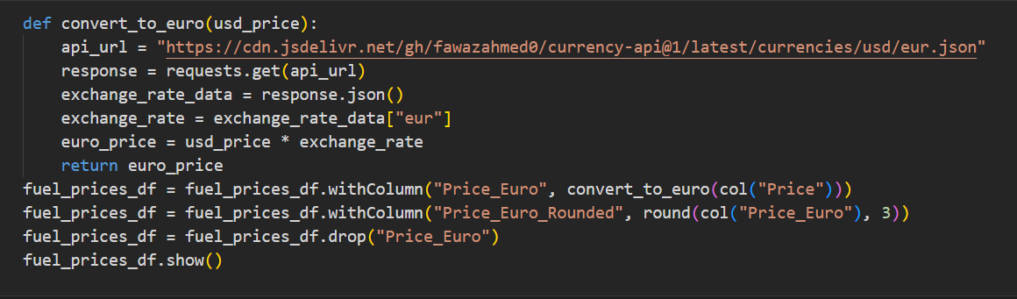
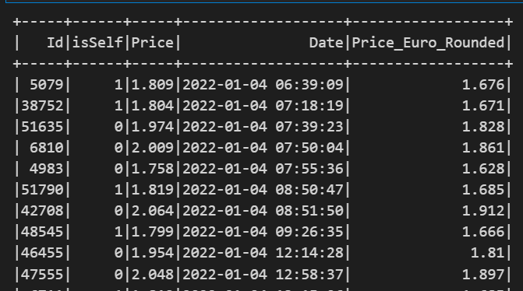
Question 1: UDF - Currency Conversion
Gasoline prices were successfully converted from USD to Euro using the provided UDF and exchange rate data from the API.
Input:
Output:

Slide 9
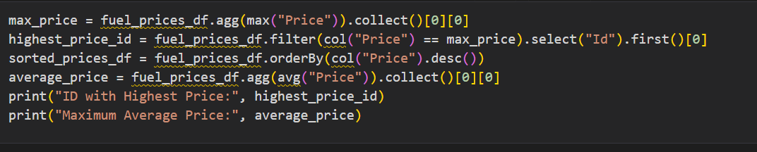

Question 2: Highest Price and Average
ID with Highest Price: 54771
Maximum Average Price: 1.835294686861716
Input:
Output:

Slide 10
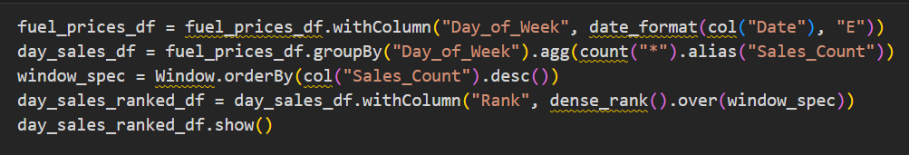
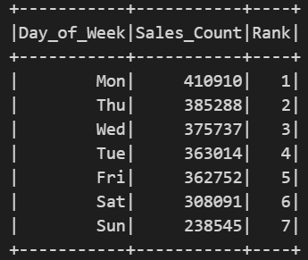
Question 3: Day of the Week Analysis
The dataset now includes a new column "Day_of_Week" with corresponding day names. The days are ranked based on sales counts.
Input:
Output:

Slide 11
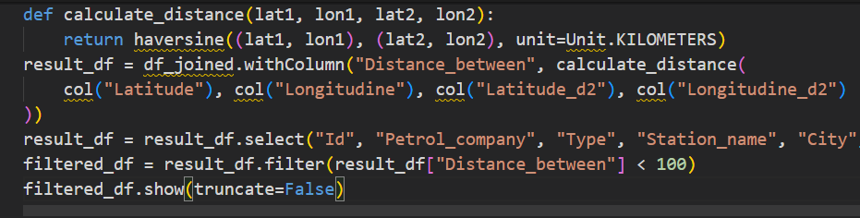
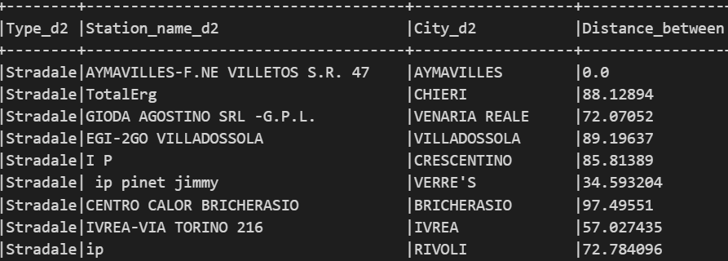
Question 4: Unique Cities and Nearby Fuel Stations
A list of unique cities was obtained. For each city, the number of other fuel stations present within a 100km radius was determined.
Input:
Output:

Slide 12
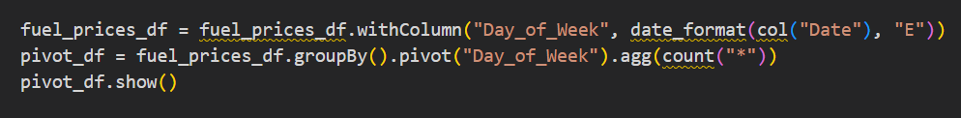
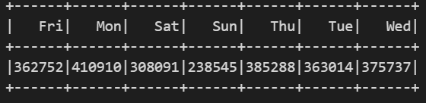
Question 5: Pivot Table and Day Counts
A pivot table was created to display the count of sales for each day of the week.
Input:
Output:

Slide 13
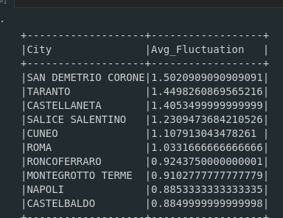
Question 6: Top 10 cities with the highest price fluctuations
Total revenue generated by each petrol company for self-service fuel stations in 5 cities, categorized by fuel station types, was calculated.
Output:

Slide 14
Question 7: Month with lowest number of hourly records.
It gives the month with lowest number of hourly records for any given city
Output:

Slide 15
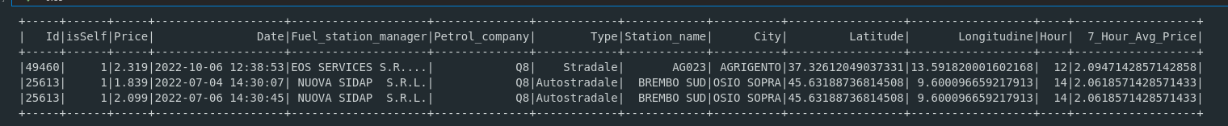
Question 8: Rolling 7-Hour Average Gasoline Price
It gives Rolling 7-Hour price average for given petro company.
Output:

Slide 16
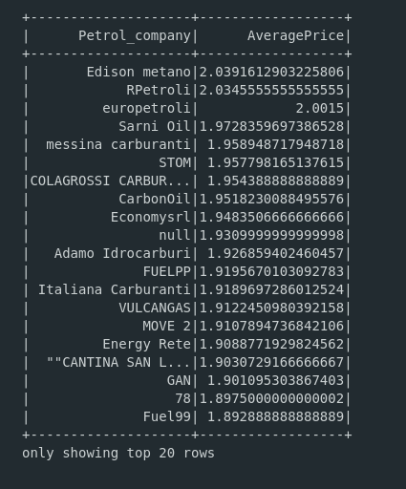
Question 9: Average Gasoline Prices by Petrol Company
It gives us insight about average gasoline prices by petrol_company.
Output:

Slide 17
Question 10: Highest Average Hourly Gasoline Price
It gives the output about highest average hourly gasoline price.
Output:

Slide 18
Thank You !

